Slide 1
Transform Method for
Markov-Modulated Queues
Izzy Grosof (IEMS) and Daniela Hurtado-Lange (Kellogg)
Northwestern University
Allerton 2025 — September 18th, 2025

Slide 2
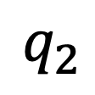

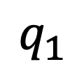
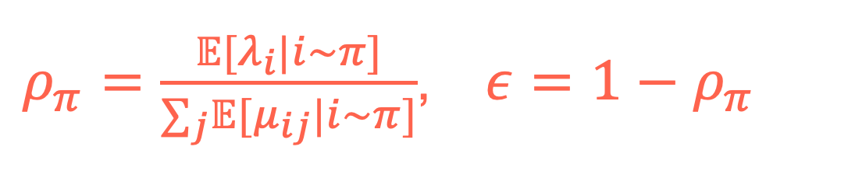

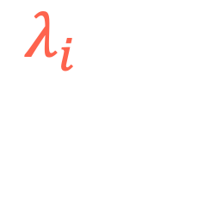
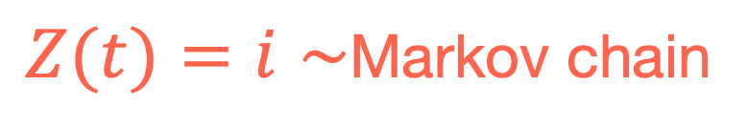

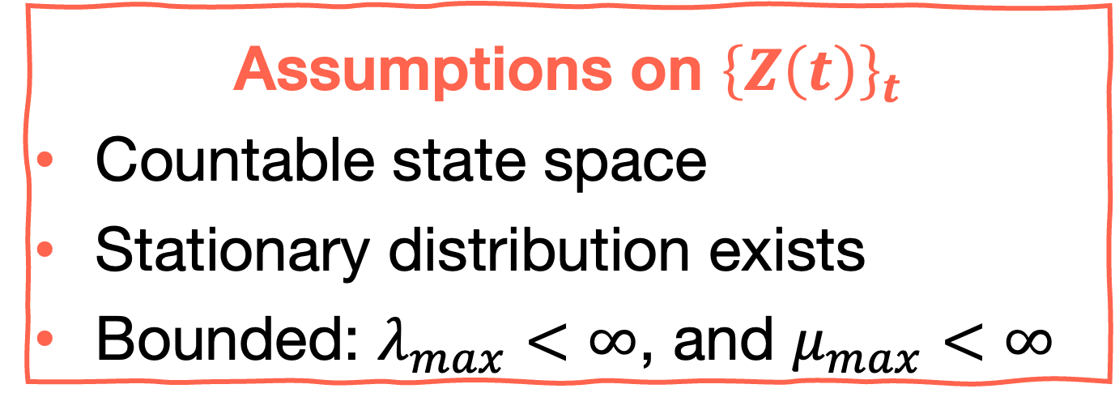

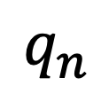
JSQ Model
Load balancing under Join-the-Shortest-Queue (JSQ)
Exponential inter-arrival and service times
Heterogeneous servers
Arrival and service rate are Markov-Modulated
$$q_{1}$$
1
$$μ_{i,1}$$
JSQ
2
…
$$q_{2}$$
…
$$λ_{i}$$
$$μ_{i,2}$$
$$q_{n}$$
$$n$$
$$μ_{i,n}$$
$Z(t)=i∼$Markov chain
Assumptions on ${\left\{Z\left(t\right)\right\}}_{t}$
Countable state space
Stationary distribution exists
Bounded: $λ_{max}<∞$, and $μ_{max}<∞$
$ρ_{π}=\frac{𝔼[λ_{i}|i∼π]}{∑_{j}𝔼[μ_{ij}|i∼π]}$, $ε=1−ρ_{π}$

Slide 3


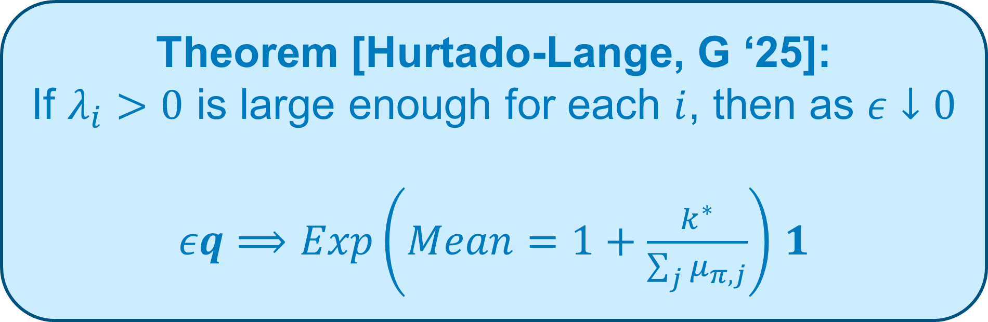
Asymptotic Distribution of Queue Lengths
Theorem [Hurtado-Lange, G ‘25]:
If $λ_{i}>0$ is large enough for each $i$, then as $ε↓0$
$εq⟹Exp\left(Mean=1+\frac{k^{∗}}{\sum_{j}{μ_{π,j}}}\right)$ $1$
$$q_{1}$$
1
$$μ_{i,1}$$
JSQ
2
…
$$q_{2}$$
…
$$λ_{i}$$
$$μ_{i,2}$$
$$q_{n}$$
$$n$$
$$μ_{i,n}$$
$i∼$Markov chain
$≈$ Variance of arrival and service times in steady state
$ρ_{π}=\frac{𝔼[λ_{i}|i∼π]}{∑_{j}𝔼[μ_{ij}|i∼π]}$, $ε=1−ρ_{π}$
Notes:
K^*: I’ll show you what it is over the course of this talk. Showed up before in previous Markov-modulated results, like my RESET&MARC and MSR papers

Slide 4




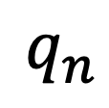
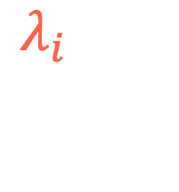

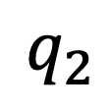
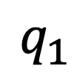
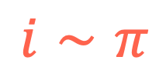
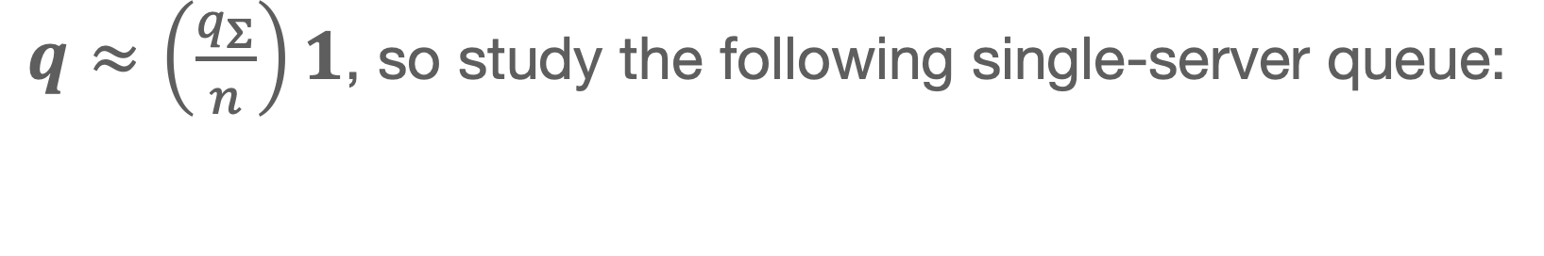

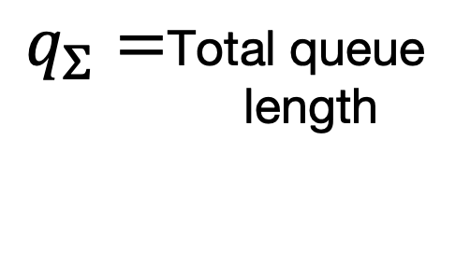
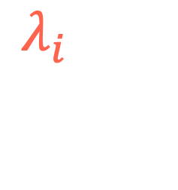
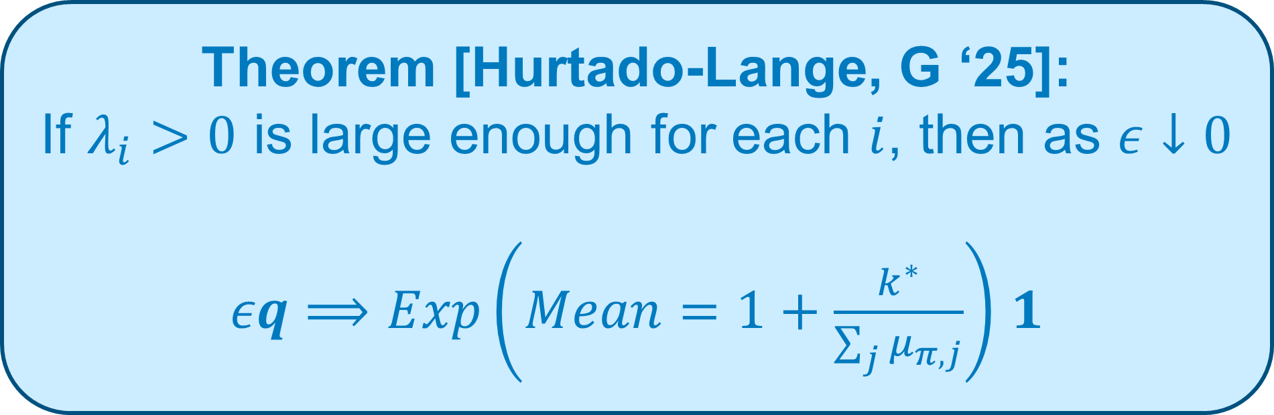
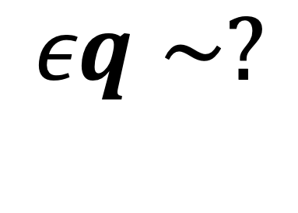
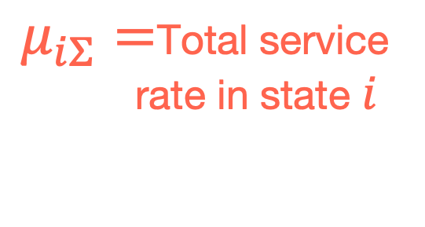

Proof Sketch
Theorem [Hurtado-Lange, G ‘25]:
If $λ_{i}>0$ is large enough for each $i$, then as $ε↓0$
$εq⟹Exp\left(Mean=1+\frac{k^{∗}}{\sum_{j}{μ_{π,j}}}\right)$ $1$
$$εq∼?$$
$$q_{1}$$
1
$$μ_{i,1}$$
JSQ
2
…
$$q_{2}$$
…
$$λ_{i}$$
$$μ_{i,2}$$
$$i∼π$$
$$n$$
$$q_{n}$$
$$μ_{i,n}$$
Step 2: Asymptotic distribution
$$εq_{Σ}∼?$$
We use:
Transform Method
Poisson Equation
Step 1: State Space Collapse (SSC)
$q≈\left(\frac{q_{Σ}}{n}\right)1$, so study the following single-server queue:
$q_{Σ}=$Total queue
length
$$λ_{i}$$
$μ_{iΣ}=$Total service
rate in state $i$
Notes:
Outline

Slide 5
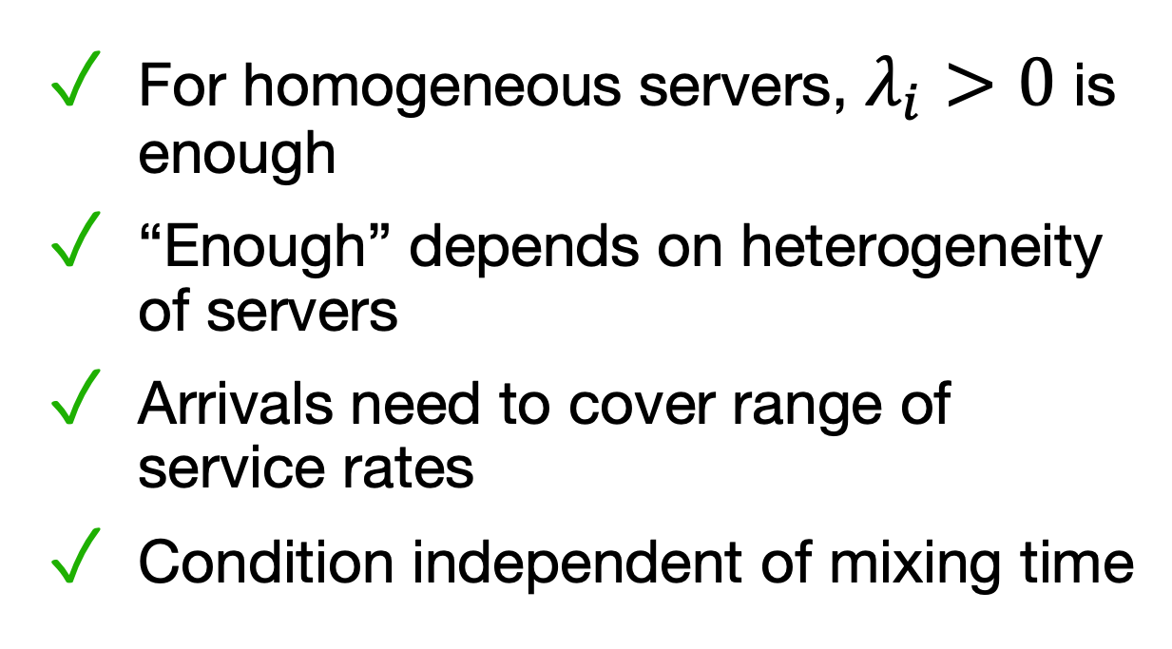

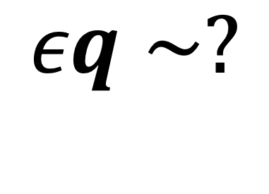

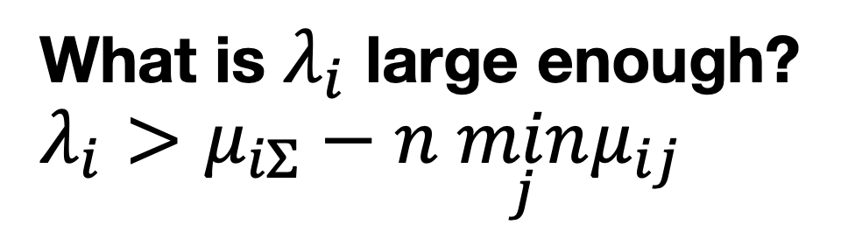

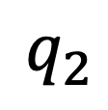





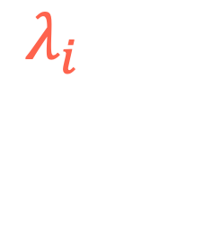
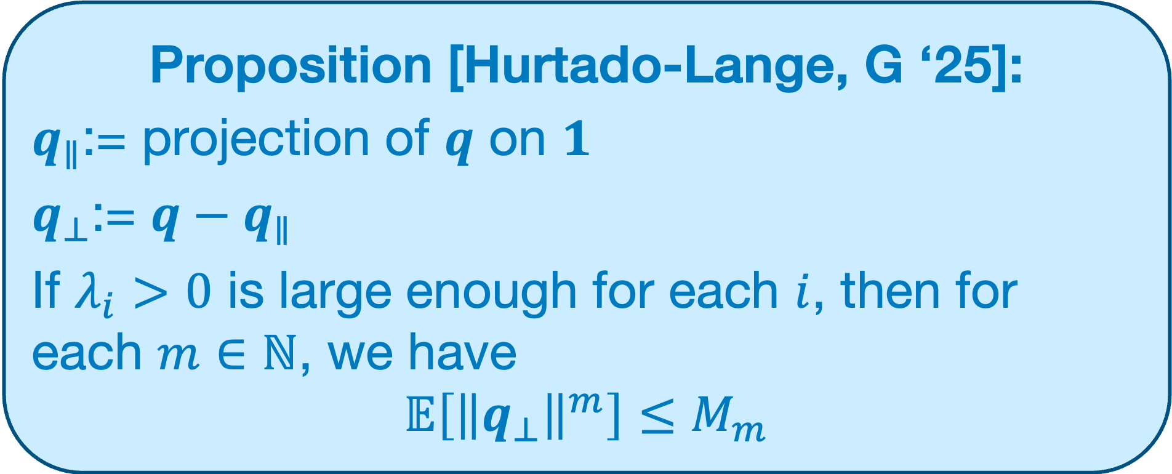
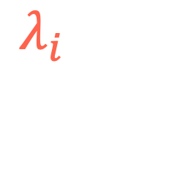
State Space Collapse (SSC)
Proposition [Hurtado-Lange, G ‘25]:
$q_{∥}$:= projection of $q$ on $1$
$q_{⊥}$:= $q−q_{∥}$
If $λ_{i}>0$ is large enough for each $i$, then for each $m∈ℕ$, we have
$$𝔼\left[{\left\|q_{⊥}\right\|}^{m}\right]≤M_{m}$$
$$εq∼?$$
$$q_{1}$$
1
$$μ_{i,1}$$
JSQ
2
…
$$q_{2}$$
…
$$λ_{i}$$
$$μ_{i,2}$$
$$i∼π$$
$$n$$
$$q_{n}$$
$$μ_{i,n}$$
Proof: Drift analysis
$$ε↓0$$
SSC
For homogeneous servers, $λ_{i}>0$ is enough
“Enough” depends on heterogeneity of servers
Arrivals need to cover range of service rates
Condition independent of mixing time
What is $λ_{i}$ large enough?
$$λ_{i}>μ_{iΣ}−n \min_{j}μ_{ij}$$
$$q_{Σ}$$
$$λ_{i}$$
$$μ_{iΣ}$$
When does JSQ balance the queue lengths?
Notes:
“Enough arrivals to balance the completion heterogeneity
If l_i is smaller, the collapse tightness will depend on mixing time. With this condition, even if mixing time grows with epsilon -> 0, still SSC.

Slide 6


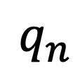


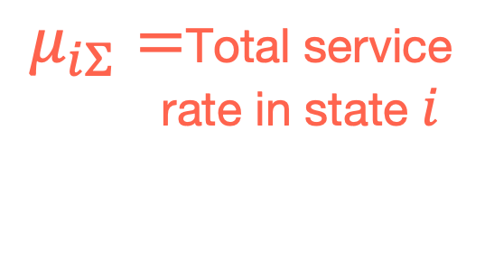
Proof Sketch
Theorem [Hurtado-Lange, G ‘25]:
If $λ_{i}>0$ is large enough for each $i$, then as $ε↓0$
$εq⟹Exp\left(Mean=1+\frac{k^{∗}}{\sum_{j}{μ_{π,j}}}\right)$ $1$
$$εq∼?$$
$$q_{1}$$
1
$$μ_{i,1}$$
JSQ
2
…
$$q_{2}$$
…
$$λ_{i}$$
$$μ_{i,2}$$
$$i∼π$$
$$n$$
$$q_{n}$$
$$μ_{i,n}$$
Step 2: Asymptotic distribution
$$εq_{Σ}∼?$$
We use:
Transform Method
Poisson Equation
Step 1: State Space Collapse (SSC)
$q≈\left(\frac{q_{Σ}}{n}\right)1$, so study the following single-server queue:
$q_{Σ}=$Total queue
length
$$λ_{i}$$
$μ_{iΣ}=$Total service
rate in state $i$
Notes:
Step 1 complete!

Slide 7






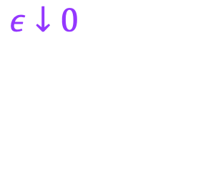

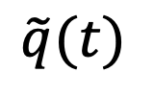
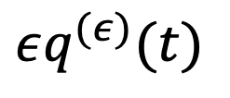

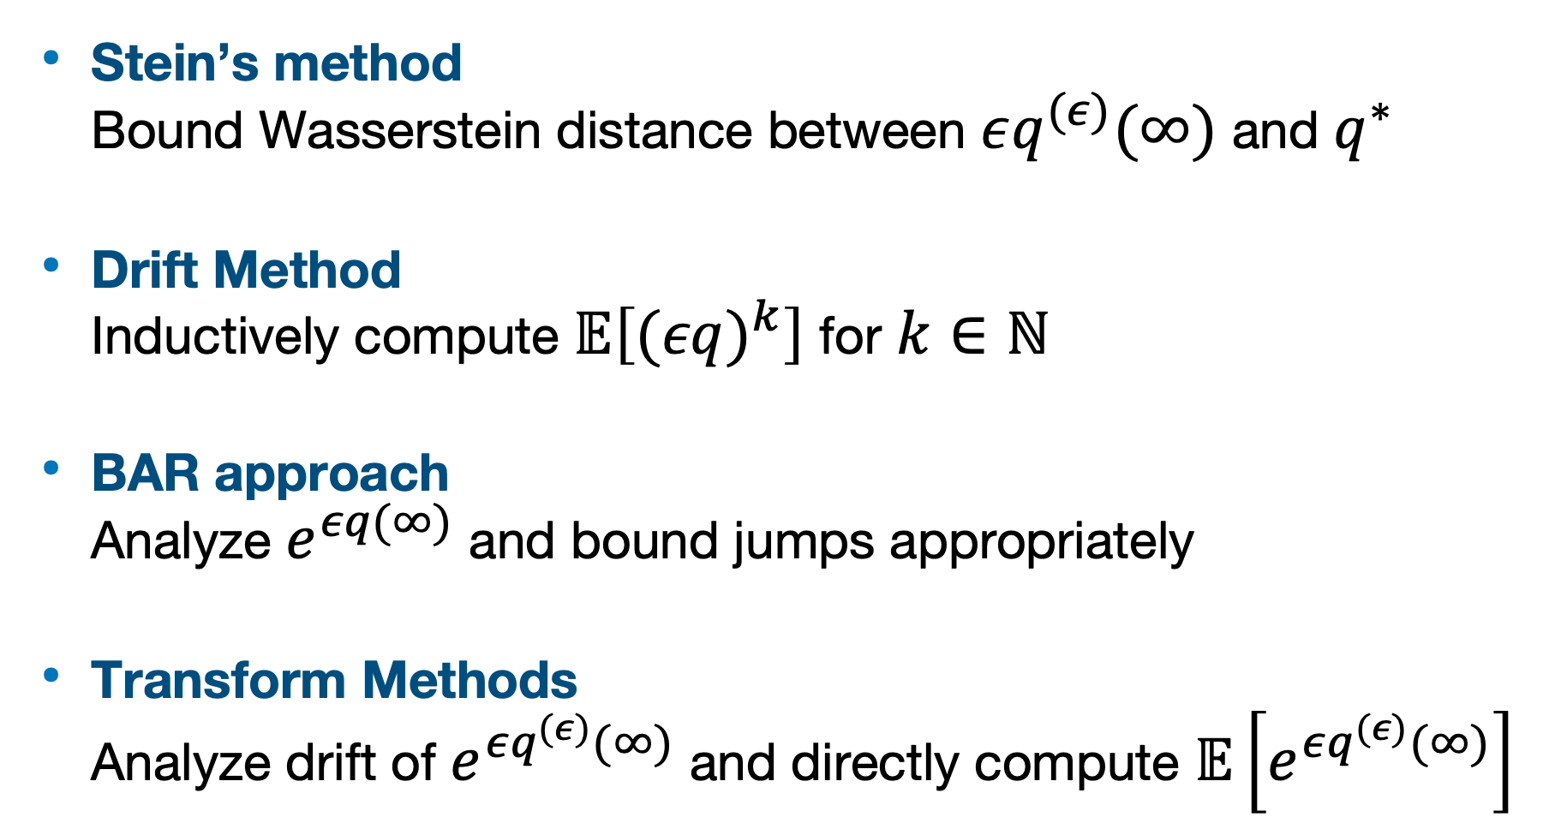
Heavy-Traffic Analysis in the Literature
Diffusion Limits Approach
Direct Methods
Most popular
Introduced by Kingman (1962)
Show convergence in distribution of queue length scaled heavy-traffic parameter $1−ρ$
Stein’s method
Bound Wasserstein distance between $εq^{(ε)}(∞)$ and $q^{∗}$
Drift Method
Inductively compute $𝔼\left[(εq)^{k}\right]$ for $k∈ℕ$
BAR approach
Analyze $e^{εq(∞)}$ and bound jumps appropriately
Transform Methods
Analyze drift of $e^{εq^{(ε)}(∞)}$ and directly compute $𝔼\left[e^{εq^{(ε)}(∞)}\right]$
$$εq^{(ε)}(t)$$
$$t→∞$$
$$εq^{(ε)}(∞)$$
$$ε↓0$$
$$ε↓0$$
$$t→∞$$
Interchange of limits
$$\tilde{q}(t)$$
$$q^{∗}$$
RBM
Tractable analysis
Compute distribution
Obtain tail bounds
Notes:
Daniela’s the expert

Slide 8

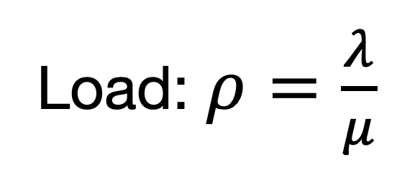
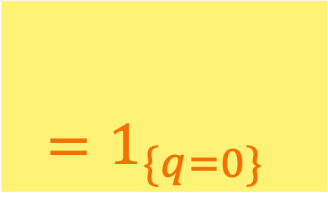
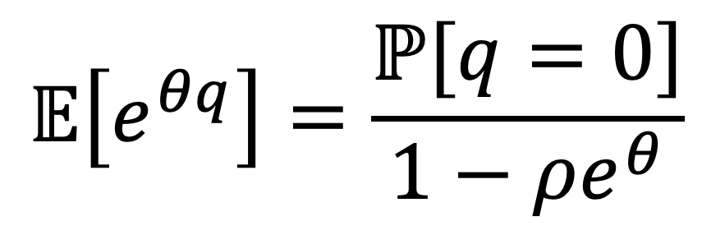
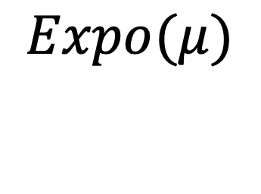
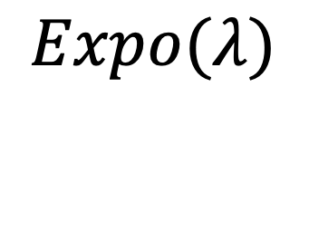




Transform Method for $M/M/1$ queue
Step 1: Drift of exponential test function
$$X_{θ}(q)=e^{θq},θ∈ℝ$$
$$Expo(μ)$$
$$Expo(λ)$$
Load: $ρ=\frac{λ}{μ}$
Arrival
Departure
$ΔX_{θ}(q)=$ $λ(e^{θ(q+1)}−e^{θq})$ $+$ $μ1_{\{q>0\}}(e^{θ(q−1)}−e^{θq})$
Drift: $ΔX_{θ}(q)=𝔼\left[e^{θq(t+)}−e^{θq}|q(t)=q\right]$
$$=e^{θq}\left(e^{−θ}−1\right)\left(μ−λe^{θ}\right)−μ\left(e^{−θ}−1\right)e^{θq}1_{\{q=0\}}$$
$$=1_{\{q=0\}}$$
Step 2: Set drift to zero
$$𝔼\left[e^{θq}\right]=\frac{ℙ[q=0]}{1−ρe^{θ}}$$
$$𝔼\left[e^{θq}\right]=\frac{1−ρ}{1−ρe^{θ}} \\ ⟺q∼\text{Geometric}(1−ρ)$$
Step 3: Set $θ=0$
$$ℙ[q=0]=1−ρ$$
Notes:
Little tutorial

Slide 9














Transform Method Markov-Mod JSQ
$$i∼π$$
$$q_{1}$$
1
Step 1: Drift of exponential test function
$$X_{s}(i,q)=e^{−sεq_{Σ}},s>0$$
$$μ_{i,1}$$
JSQ
$$q_{2}$$
2
…
…
$$λ_{i}$$
$$μ_{i,2}$$
$$ΔX_{s}(i,q)=\left(e^{−sε}−1\right)e^{−sεq_{Σ}}(λ_{i}−μ_{iΣ}e^{sε})$$
$−\left(e^{−sε}−1\right)e^{−sεq_{Σ}}(\underset{j}{∑}μ_{ij}1_{\{q_{j}=0\}})$
$$q_{n}$$
$$n$$
$$μ_{i,n}$$
$$ε↓0$$
SSC
$≈\underset{j}{∑}μ_{ij}e^{−sεq_{j}}1_{\{q_{j}=0\}}$ (SSC)
$$q_{Σ}$$
$$=\underset{j}{∑}μ_{ij}1_{\{q_{j}=0\}}$$
$$λ_{i}$$
$$μ_{iΣ}$$
$$ε:=1−ρ_{π}=1−\frac{𝔼[λ_{i}|i∼π]}{∑_{j}𝔼[μ_{ij}|i∼π]}$$
Notes:
This is where we use SSC! One empty queue means all queues close to empty.

Slide 10




Transform Method Markov-Mod JSQ
$$i∼π$$
$$q_{1}$$
1
Step 1: Drift of exponential test function
$$X_{s}(i,q)=e^{−sεq_{Σ}},s>0$$
$$μ_{i,1}$$
JSQ
$$q_{2}$$
2
…
…
Not independent!
How to compute $𝔼[ΔX_{s}(i,q)]?$
$$λ_{i}$$
$$μ_{i,2}$$
We use the Poisson equation!
$$q_{n}$$
$$n$$
$$ΔX_{s}(i,q)=\left(e^{−sε}−1\right)e^{−sεq_{Σ}}(λ_{i}−μ_{iΣ}e^{sε})$$
$−\left(1−e^{sε}\right)(\underset{j}{∑}μ_{ij}1_{\{q_{j}=0\}})$
$$μ_{i,n}$$
$$ε↓0$$
SSC
$$q_{Σ}$$
$$𝔼[\underset{j}{∑}μ_{ij}1_{\{q_{j}=0\}}]=μ_{Σ}ε$$
$$λ_{i}$$
$$μ_{iΣ}$$
$$ε:=1−ρ_{π}=1−\frac{𝔼[λ_{i}|i∼π]}{∑_{j}𝔼[μ_{ij}|i∼π]}$$
Notes:
Oh no! A cross term! We don’t know the correlation between q_sum and i! So we use the Poisson equation

Slide 11



Poisson Equation for Transform Method
Poisson equation:
Let ${\left\{Z\left(t\right)\right\}}_{t}$ be a CTMC with countable state space $𝒵$ and transition rates $α_{i,i’}$
Consider a function $f:𝒵→ℝ$ and let $\overline{f}=𝔼\left[f(Z)\right]$. Then, there exists a function $V_{f}:𝒵→ℝ$ such that
$$V_{f}\left(i\right)=\frac{f\left(i\right)−\overline{f}}{α_{i⋅}}+\sum_{i’≠i}{\frac{α_{i,i’}}{α_{i⋅}}}V_{f}(i’)$$
$$Z\left(t\right)∼$$
Theorem [Hurtado-Lange, G ‘25]:
For any function $f:𝒵→ℝ$ such that $V_{f}\left(i\right)$ exists and $𝔼\left[{\left|V_{f}\left(i\right)\right|}^{1+η}\right]<∞$ for some $η>0$, we have
$$Cov\left(e^{−sεq_{Σ}},f\left(i\right)\right)=𝔼\left[e^{−sεq_{Σ}}f\left(i\right)\right] −𝔼\left[e^{−sεq_{Σ}}\right]\overline{f}=\left(e^{−sε}−1\right)𝔼\left[e^{−sεq_{Σ}}V_{f}\left(i\right)\left(λ_{i}−μ_{iΣ}\right)\right]+O\left(ε^{2−\frac{1}{1+η}}\right)$$
Solution to Poisson equation
Error term
Separate expectation of product
Notes:
Covariance of q term and I term! Leading order term involves Poisson equation

Slide 12

Applying the Poisson Equation
Set drift $𝔼\left[ΔX_{s}(i,q)\right]$to zero:
$$𝔼[e^{−sεq_{Σ}}(e^{sε}μ_{iΣ}−λ_{i})]=e^{sε}μ_{Σ}ε+O(ε^{2})$$
$$=𝔼\left[e^{−sεq_{Σ}}\left(μ_{iΣ}−λ_{i}\right)\right]+sε𝔼\left[e^{−sεq_{Σ}}μ_{iΣ}\right]+O\left(ε^{2}\right)$$
Poisson equation theorem $f(i)=h(i)≔μ_{iΣ}−λ_{i}$ and $f\left(i\right)=u\left(i\right)≔μ_{iΣ}$:
$$𝔼[e^{−sεq_{Σ}}(e^{sε}μ_{iΣ}−λ_{i})]=𝔼[e^{−sεq_{Σ}}](1+s)μ_{Σ}+(1−e^{−sε})𝔼[e^{−sεq_{Σ}}V_{h}(i)(μ_{iΣ}−λ_{i})]+O(ε^{2−\frac{1}{1+η}})$$
Poisson equation theorem with $f(i)=k(i):=V_{h}(i)(μ_{iΣ}−λ_{i})$ :
$$𝔼[e^{−sεq_{Σ}}V_{h}(i)(μ_{iΣ}−λ_{i})]=𝔼[e^{−sεq_{Σ}}]𝔼[k(i)]+O(ε)$$
Then, put everything together.

Slide 13
















Key Takeaways
Step 1: State Space Collapse
$$εq∼?$$
$$q_{1}$$
1
$$μ_{i,1}$$
$$≈$$
JSQ
2
$$q_{Σ}$$
…
$$q_{2}$$
…
$$λ_{i}$$
$$μ_{iΣ}$$
$$λ_{i}$$
$$μ_{i,2}$$
Queue can be unstable for some $i$
Only need $λ_{i}$ large enough so JSQ balances queue lengths for all $i$
  Otherwise, might need another routing policy
$$i∼π$$
$$n$$
$$q_{n}$$
$$μ_{i,n}$$
Theorem [Hurtado-Lange, G ‘25]:
$$𝔼\left[e^{−sεq_{j}}\right]=\frac{1}{1+s\left(1+\frac{𝔼\left[k\left(i\right)\right]}{μ_{πΣ}}\right)}+O\left(ε^{2−\frac{1}{1+η}}\right)$$
where $k\left(i\right)=V_{h}(i)(μ_{iΣ}−λ_{i})$ and $h\left(i\right)=μ_{iΣ}−λ_{i}$
Step 2: Asymptotic distribution
Transform Method:
$X_{s}(i,q)=e^{−sεq_{Σ}}$, $𝔼[ΔX_{s}(i,q)]=0$
+ Poisson Equation Covariance Theorem

